Slide 1
Team - Decode Brothers
Theme / Domain:Education
DSCKIIT-DEVHACK-2K20

Slide 2
PROBLEM STATEMENT
Students often feel a huge gap between what is being taught in college and what they have to do in the real world.Is there a solution to bridge the gap without them taking help of extra courses online.

Slide 3






- Rohit Sharma(web-dev)
- Sambit Majhi(app-dev,Firebase)
- Manish Bhardwaj(cyber-seq)
- Yash Tripathi(app-dev,ML)
Team Members:

Slide 4
Problem and its Solution:-
To minimize the gap between learning and application without the burden of any online courses.
Delivering ready to go and real time practice sessions to the user which are used in the industries
To let them apply their knowledge to real life problems faced in the industries and companies.
Organizing webinars to deliver the application of work by industrial professionals and developers in it firms
All the professionals of a particular branch or stream can stay connected throughout the app and share their
personal experiences about their work in their respective companies.

Slide 5
Brief explanation:-
for example the user is a software developer having the programming skills in language c,c++ and javascript then he gets placed in oracle and is put in a team for the development of company's portal which requires the basic knowledge of the language used by the company professionals, so the user can be benefited by this app by knowing the professionals work and their experiences in developing the real time applications and can apply the knowledge to it without the burden of any online course in a nutshell an app which makes you industry ready by giving a shape to your inbuilt potential but of course you can't do anything without any prior knowledge if you are a college graduate we assume that you have the basic needed knowledge of your respective fields
The interface can be made similar to linkedin and upgrad. but instead of searching jobs and completing your course, you are interacting with the industry professionals in a network and some extracted videos and video conferences can be arranged to give you ready to go instructions, but the main part of all this is that the user must have basic skills and the endurance to work.
e.

Slide 6
Brainstorm
Impact-less mistakes, skilled employees, more employment, smooth work,time efficient,money efficient as people spend a lot of money to buy online courses whereas this app provides you the service at much lower price,people having real time knowledge of their respective field and can be employed in various services
contributing to the economy,by interacting with the professionals the users can also develop ideas for
the startups.
We can also provide information about different options of job opportunities according to the interest of user which they can pursue to develop their skills in particular field by providing them all the important information regarding that job and what they can do to be more efficient in it so that they could be more job oriented rather than wasting their time in learning unwanted things
Actual motive

Slide 7
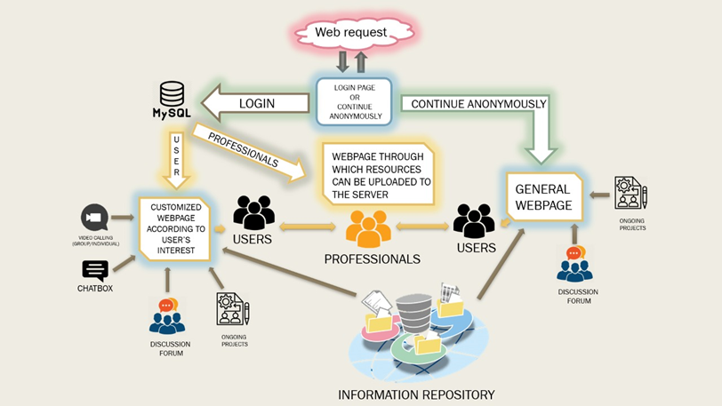
ARCHITECTURE DIAGRAM

Slide 8
Tech-Used:
Firebase - For Database Management And Hosting
Adobe XD - Prototyping
Flutter - App development
SSL - For Encryption
APRIORI - For recommendation relevance

Slide 9
BUsiness Model
The app can’t be free to use as we have to provide them regular materials , so according to the business plan the profit can be taken out from that.
The business rivals can be linkedin,upgrad and various other online learning platforms but the unique thing about our app will be that it provides learning as well as innovation and real time skills
The app motivates the user to post knowledge and information rich posts by gifting them a part of ad funds as a reward based on the posts reach and reactions.
An employee doing job or internship can do a livestream in his free time delivering resourceful content, enabling donation feature which can let him earn in their free time..
Generally 25% of a class are studious and rest other feel the same for which our app is intended to.(about 8.5 lakhs students)
This app is generally targeted to students of university and also self learners who can grow a lot by community learning and by doing in hand projects and assignment with people you are comfortable with can make you learn faster than traditional way of learning.
App is somewhat free to use(Freemium)
Only cost will be applicable for firebase usage(which can be managed by very few ads or promotions.).
Feasibility factor for this project is that knowledge never gets obsolete.

Slide 10

Thanks!
Link to protoype(video):-
Contact us:
Sambit Majhi -> [Group Leader]
majhisambit2@gmail.com
Manish Bhardwaj -> 1906402@kiit.ac.in
Rohit Sharma ->
1906419@kiit.ac.in
Yash Tripathy ->
1906450@kiit.ac.in
bit.ly/educa-prototype

